Slide 1

Cognizant Strategic plan
Preparation For Data Modelling

Slide 2
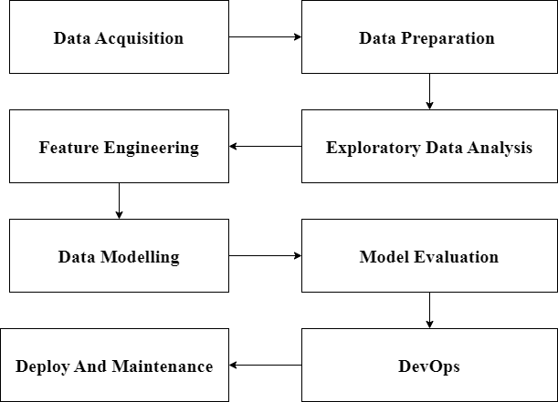
Strategic Plan - POC

Slide 3
